Slide 1
Maturing Asset Management at MnDOT: Executing the AMSIP Communications Plan
Dave Solsrud Asset Management Program Manager
Discussion with MnDOT District Management Teams Fall 2021

Slide 2
3 parts to this discussion
Part One: the AMSIP Communications Plan
Part Two: Communications Content for DMTs
Part Three: The Ask

Slide 3
Asset Management Defined
AASHTO Definition - Transportation Asset Management is a strategic and systematic process of operating, maintaining, upgrading, and expanding physical assets effectively throughout their lifecycle. It focuses on business and engineering practices for resource allocation and utilization, with the objective of better decision making based upon quality information and well defined objectives.
What does it mean to us?
Taking care of what we have - Stewardship
Efficient use of resources - Strategic
Whole life considerations - Lifecycle
Performance Based – “Objectives”
Objective Decisions – Data Based
Cost Conscious – Return on Investment
Risk considerations
Reliable Data, Data as an Asset
Tradeoffs
Transparency
Notes:
Cycle of life decisions (maintenance, planning, scoping, engineering, construction). Not just TAMS….

Slide 4
Part One: Why AMSIP?
TAMP 2018 Training April 2018 – 2 day workshop
Broad cross section of individuals affected/responsible
Roles and Responsibilities
Impacts (decision making, resources, FHWA consistency)
Future goals – 5 year plan
How far are we going?
Data and data maintenance, ROI
What to include in TAMP - Risks?
Investment strategies – Asset Management vs Everything Else
Communications – Roles and Responsibilities
Decision to create a plan “Strategic”- future state/goals, “Implementation” - do what we can now

Slide 5
Why Is AMPO Leading This?
AMPO created in 2015 to address Business Process, Tools, Data Stewardship
AMSIP codifies initial vision, lays out specific roles – communication in this case
TAMP legally required
“Implementation” legally required
Consistent with MnDOT’s Strategic Objectives, investment plans, strategic plans etc.
Right thing to do

Slide 6
What’s the Process
AMSIP
AMSIP conducted to address 5 areas
Asset Inventory Information
Geotech Asset Information
Preventive Maintenance Reliability
Asset Management Communications
Transportation Asset Management Plan
Surveys
Broad Follow-up Engagement meetings/calls
Teams of Stakeholders
Expert Consultants
Collaborative
AMSIP adopted by SLT 9/7/2021

Slide 7
Part One: The AMSIP Communications Plan
The Approach: Work Group 4: Communication
Operations | Specialty
JT Anderson – D2 | Dave Solsrud - AMPO
Jon Huseby – D8 | Chris Joyce - OC
Steve Lund - OM | Katie Zimmerman - APT
Jed Falgren - OPS | Hyun-A Park - SPP
Jeff Perkins – D4
Sheila Kauppi - M
Domingo Aguilar – D3
Mike Dougherty – D6
John Bieniek – M
Jon Mason – D2

Slide 8
Part One: The AMSIP Communications Plan
The Challenge –
The Asset Management discipline engages well over ½ the department’s employees at some level
Executive Leadership: Policies and Priorities
Planning and Programming: Investment Decisions
Expert Offices: Asset “Manager” Expertise
Program Delivery: Design decisions, Data Maintenance provisions
Operations and Maintenance: Work Planning and Prioritization
Front Line Staff: Data Recording, Inspections & Condition Recording
Financial: Forecasting, Financial Data Quality, Systems of Record
Office Staff: LEM Data Quality and Processing, Timesheets, Damage Restitution
Inventory Management: Robust Materials Business Processes
Notes:
Many have roles large and small

Slide 9
Part One: The AMSIP Communications Plan
The Challenge –
Stakeholders have vastly differing information needs:
Legal Requirements (TAMP & Consistency, MS 174.03)
Performance Expectations (PM Measures)
Asset Specific Best Practices (72 Asset Classes)
Data Acquisition and Data Maintenance; Roles, Processes, Tools
TAMS Use for Recording Accomplishments and LEM Consumption (2000 Licenses)
TAMS, Georilla, ARCGIS, BI, HPMA, BRIM tools for Analysis and Planning
How Materials Procurement Methods affect Financial Accuracy
Why???!!!
Limited “Receivers’” bandwidth available for learning
Notes:
All players are critical, yet all have vastly differing information needs

Slide 10
Part One: The AMSIP Communications Plan
The Philosophy: “People listen to their boss…” Steve Lund, 6/2020
Other Considerations:
Must explain/show why…
How does this benefit MnDOT/Constituents?
Will this data be used?
How do I fit in this picture?
Roles and Responsibilities
Messaging
Must be tailored, actionable

Slide 11
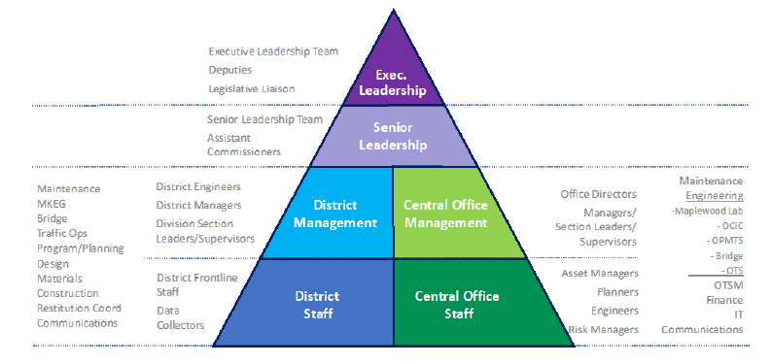
Audiences
Effort to Simplify
Gross Categorization by Role in the Agency
Effort to Group Messages
Universal Messages
Role Specific Info Needs

Slide 12
Part One: The AMSIP Communications Plan
The Approach – Categorize Information Needs:
General Asset Management Knowledge – Messaging that builds general knowledge and support for asset management.
TAMS Data –The importance of quality data and the benefits realized from the use of quality data.
Decision Making – Information that demonstrates the importance of using TAMS data and asset management principles to guide work planning, to understand trade-offs in budget-setting activities, and to manage performance, minimize Life-cycle costs and extend service life.
TAMP Implementation – Support the on-going implementation of the TAMP at MnDOT.
Coordination With External Stakeholders – Information for MnDOT’s use in communicating asset management information to external stakeholders.

Slide 13
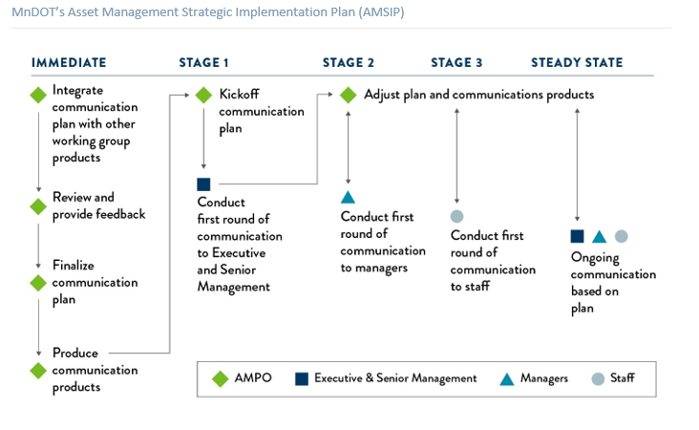
Part One: The AMSIP Communications Plan
The Approach – Execute the plan in stages:
AMPO present to SLT in Dec
AMPO present to DMTs in Dec/Jan
AMPO present to DLTs in Jan/Feb/Mar
AMPO present to Offices in Feb/Mar/Apr
Note that the approach is by District and Office – Not MG/Functional
Execution via Organizational Leaders and Supervisors Messaging to their reports

Slide 14
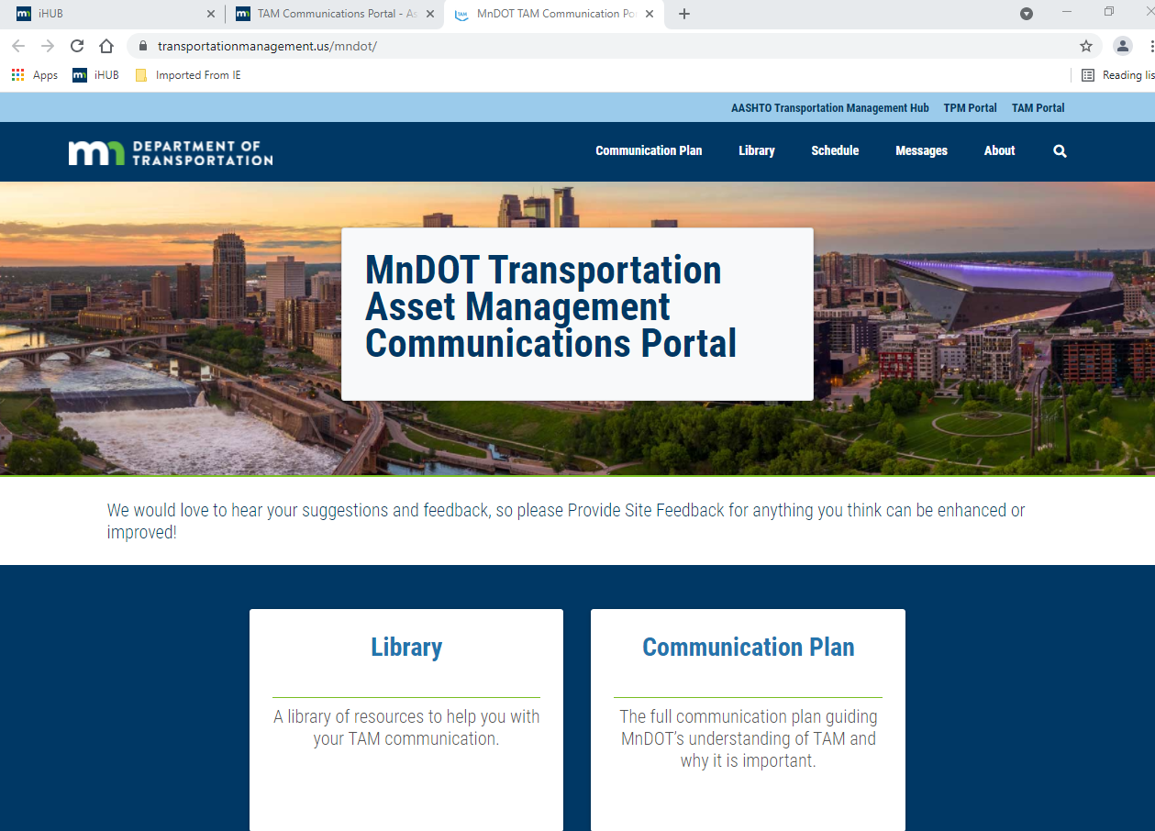
Part One: The AMSIP Communications Plan
Resources:
Notes:
AASHTO Web Portal
Accessible
Multiple materials types

Slide 15
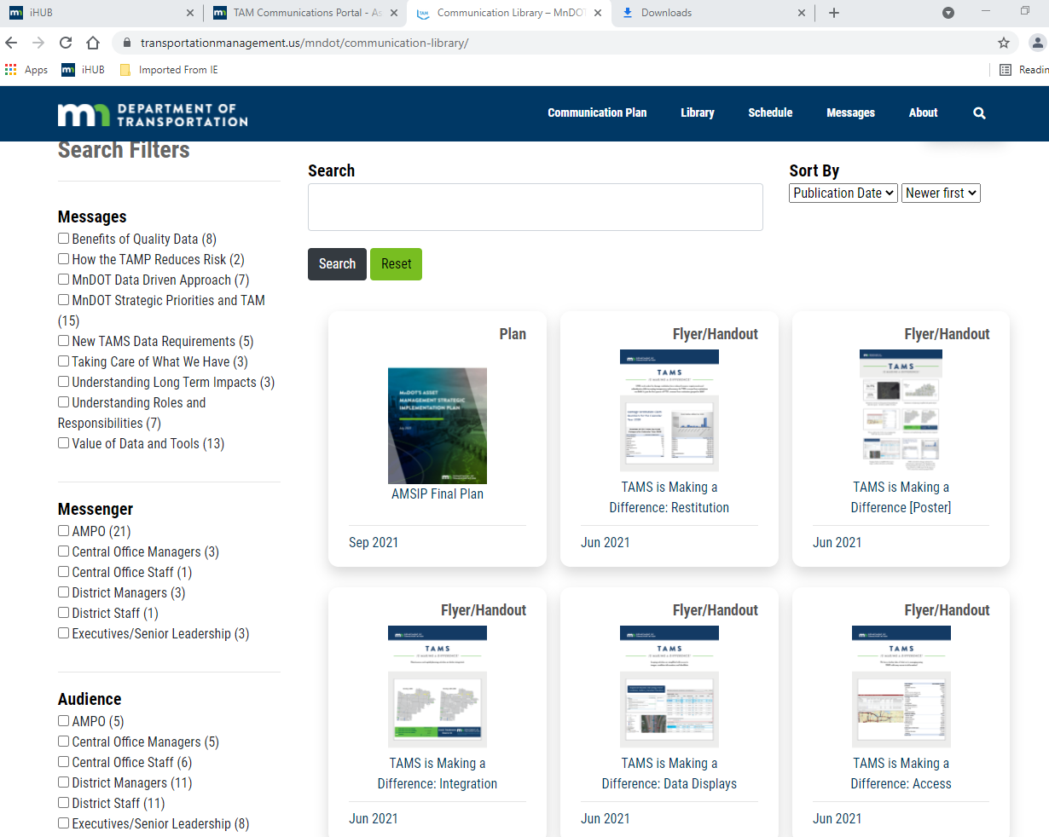
Part One: The AMSIP Communications Plan
Resources
Notes:
AASHTO Web Portal
Searchable by tags
When we meet with DMT’s and Leaders we can take requests

Slide 16
Part Two: DMT Communications Content
Example “Roles & Responsibilities
Planners - PM investments
Materials – PM, PIE
Project Managers - As-Built provisions
Pre-Design – Scoping Data
Design – As-Built Spec
Hydraulics – Performance Measures
Example “Roles & Responsibilities
Construction – As-Built
Maintenance – Work Planning, TAMS use
Traffic - TAMS
Bridge - PM, Structural Inspections, WOM use
Signs – TAMS use, data maintenance
Inventory
Damage Restitution

Slide 17
Part Two: DMT Communications Content
 | General TAM Knowledge | TAMS Data | Decision Making | TAMP Implementation | Coordination with Stakeholders
What is the message? | What asset management means at MnDOT and why we do it Asset management is aligned with MnDOT’s strategic objectives & Plans Good data leads to better decisions Asset management has already improved efficiency Asset management can make your job easier/better Why are you the one to do this particular job (e.g., collect or enter data)? This is how we use the information you collect MnSHIP and the TAMP drive infrastructure investments | By using the data. we can better time our investments to increase life of assets, maximize efficiency Asset management helps manage investments across the system (Trade offs) Inspections reduce risk Field staff efforts optimized through high priority work planning | Field staff and other resources are optimized by focusing on highest priority work Data helps identify better timing for asset investments Data assists in making better work planning for maintenance Data can support Scoping, Design | TAMP and Consistency are legal requirements With limited budgets, data helps investments efficiency | MnDOT strives to be good steward of assets MnDOT considers multiple factors and trade-offs prior to committing to investments MnDOT utilizes data and performance measures to influence capital investments
Notes:
All players are critical, yet all have vastly differing information needs

Slide 18
Part Two: DMT Communications Content
 | General TAM Knowledge | TAMS Data | Decision Making | TAMP Implementation | Coordination with Stakeholders
Why do we need to communicate the message? | To build a general understanding of MnDOT’s asset management program and its importance among staff To build an understanding of the importance of each individual’s role in supporting asset management To share MnDOT’s asset management goals and objectives | To build an understanding of the value of data and related tools Data helps us “Tell Our Story” To demonstrate the benefits of making decisions using quality data To show investment timing is improved by using data | To explain how TAMS data and asset management principles help guide work planning To build an understanding of trade-offs in budget setting activities To explain how data assists in managing assets to performance targets | To explain the match between program goals and the TAMP commitments To ensure MnDOT achieves “Consistency” findings by FHWA To ensure performance expectations for each asset are achieved | To illustrate that MnDOT is a good steward of taxpayer dollars to enhance customer trust To provide managers and supervisors with enough knowledge to be able to explain/persuade the benefits to others To enhance customer trust
Notes:
All players are critical, yet all have vastly differing information needs

Slide 19
Part Two: DMT Communications Content
 | General TAM Knowledge | TAMS Data | Decision Making | TAMP Implementation | Coordination with Stakeholders
How should we deliver the message? | Group meetings Use of TAM Portal Resources Targeted emails Flyer/Pamphlet Video Training FAQs with links to answers | Same | Same | Same | Existing Meeting Venues
Notes:
All players are critical, yet all have vastly differing information needs

Slide 20
The Ask
Meet with your reports
Share AMSIP as relevant
MnDOT Vision, Objectives
Why
What does it mean to me?
Investment Decision making
Maintenance Work Planning
Data Recording – TAMS, other
Infrastructure data maintenance
Performance Measures & Targets
Capital (PM)
Maintenance
“Downchain” communications
Carry message further
Feedback from meetings
Assess Buy-in
Challenges
Suggestions
Requests
Convey back to AMPO
Learnings
Issues
Suggestions

Slide 21
District Planning Dialog
What makes sense for district outreach?
Supervisors?
Support needed?
Employee tailored messages (Sups know what their folks need to know)
Portal
AMSIP Comms chapter PDF?
AMSIP whole doc?

Slide 22
Thank you!
Dave Solsrud
Dave.Solsrud@state.mn.us

